Slide 1
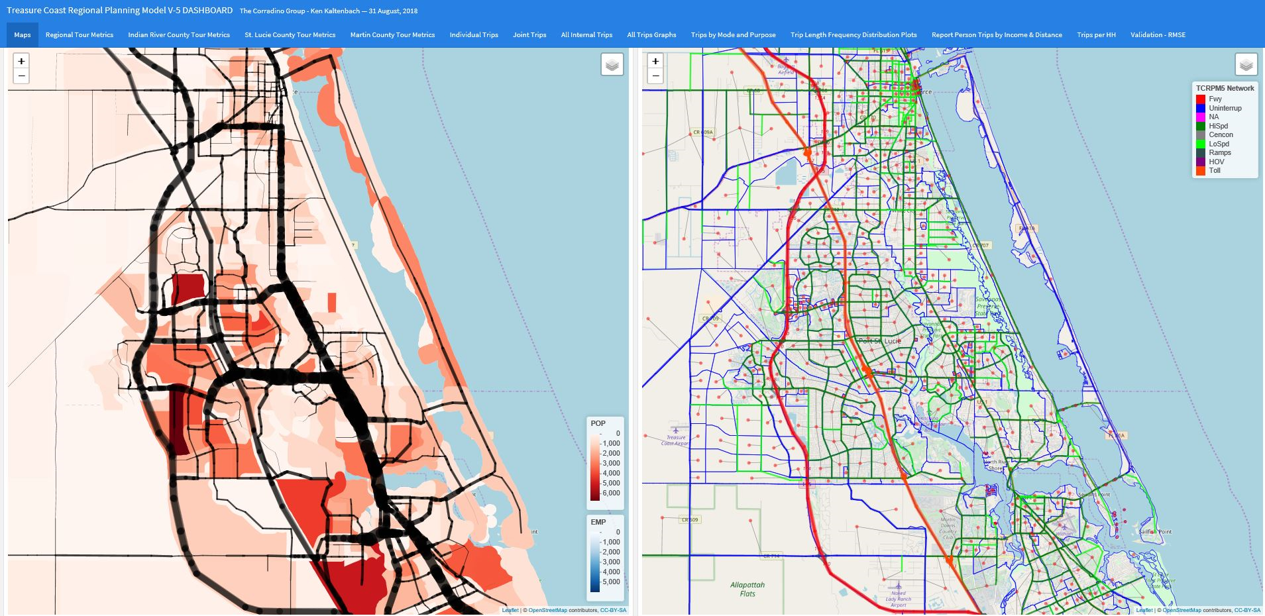
TCRPM 5 Dashboard 17th National Transportation Planning Applications Conference June 3, 2019 The Corradino Group, Inc.

Slide 2
Location Map

Slide 3
Purpose and Motivation
Visualize and Display Activity-Based-Model Output
Works just as well for trip base models
Make it Easy and Routine – Standard Model Reporting
Introduce New Software and Methods
Provide a “starting point” for New Reporting Standards
Output=html
Screen
Web
Reports
Currently in use for model validation

Slide 4
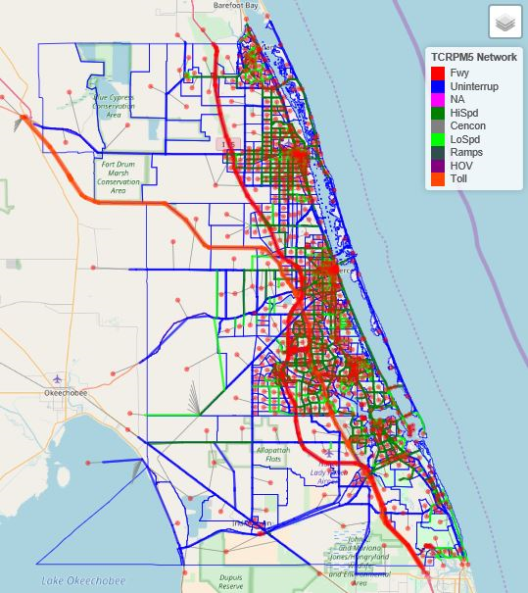
Treasure Coast Regional Planning Model Version 5
Cube Voyager Framework
2015 Base Year, updated from 2010 (Version 5)
New HH Survey for model design, estimation, calibration and validation
CTRAMP ABM
Second ABM version for TCRPM.
Relatively small area – runs on a laptop (i7, 500GB disk, 16 GB ram).
Population = 575,000
# TAZ’s = MAZ’s = 1,100
Includes all ground modes
Overs Three Counties (north of Palm Beach County)
User-friendliness & visualization emphasis
Provide tools to use the ABM data.
Widely used by 3 MPO’s, FDOT, and Consultants
“Pushed out” to the planning and modeling community

Slide 5
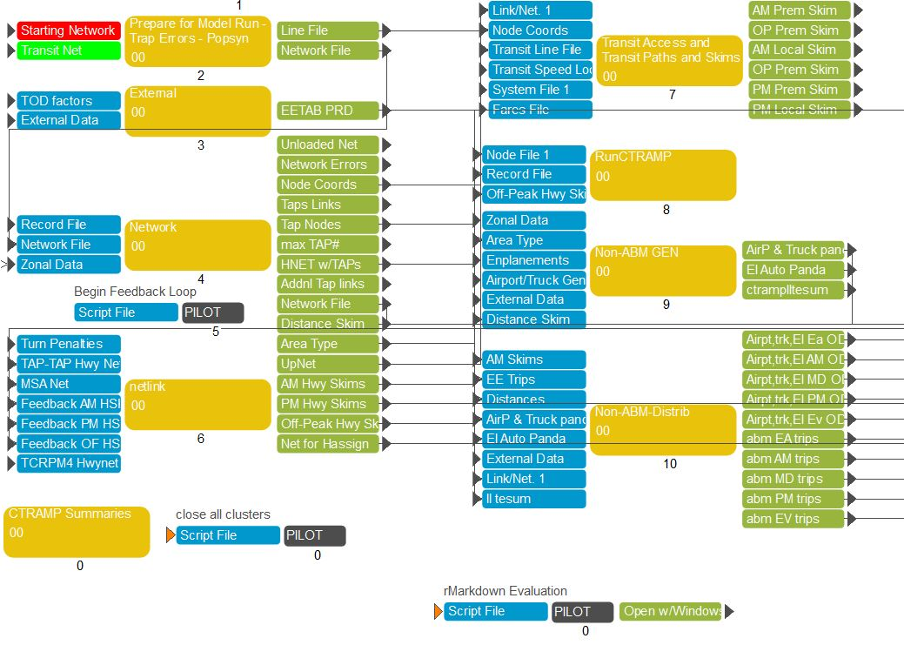
Dashboard Framework
R and R Studio (all free and open-source)
rMarkdown
Flexdashboard
Ggplot2
Ploty
Leaflet & Open Street Map
Reads ArcMap mapping files (shape & geodatabase)
Data from CUBE Voyager as comma-delimited files
Called directly from the Cube flowchart
Simple “calling” method from Cube “Pilot”:
*c:\tcrpm4\dashb\rmtest c:/tcrpm4/dashb/tcrpm5-dash.Rmd c:/tcrpm4/dashb/tcrpm5-dash.html {year}{ALT} c:/tcrpm4 {SAMPLERATE}

Slide 6
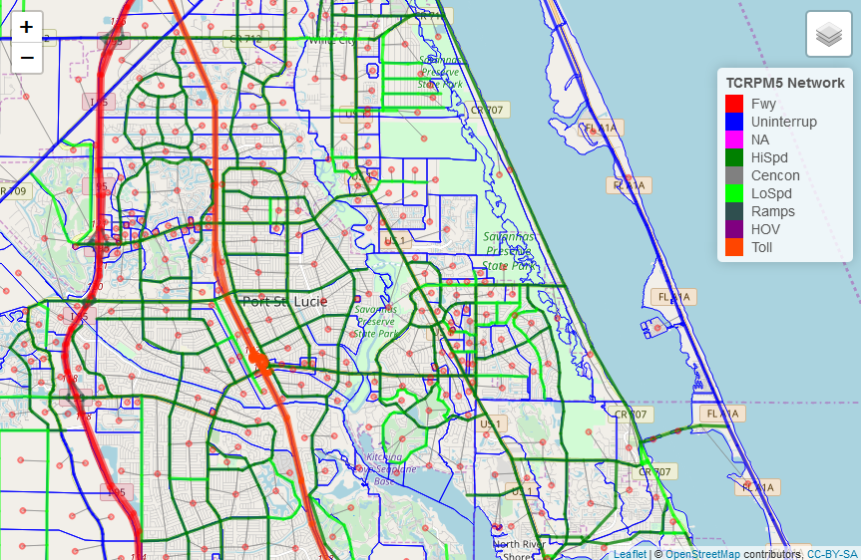
Maps
Demographic Themes (input & popsyn)
Household data
Auto availability
Employment
Network Displays (input and assignment results)
Links
Nodes
Centroids
Flows, Counts, V/C
Open Street Map Base
Not a replacement for GIS

Slide 7
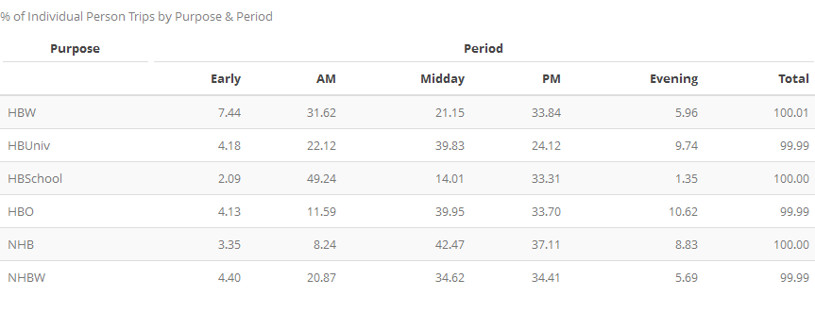
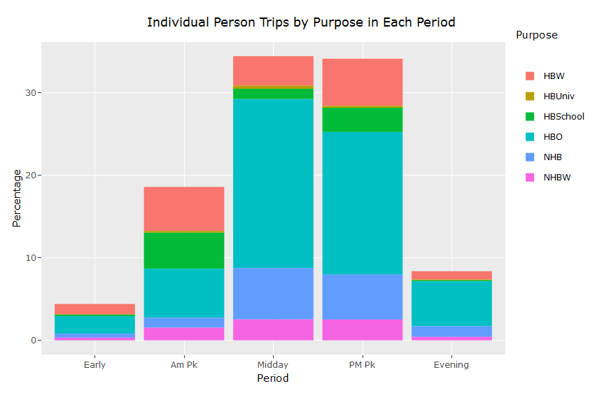
CTRAMP ABM OUTPUT
Example: Individual Trips
From the Population Synthesizer
Household Data
Person File
MAZ data (employment, visitors)
From the Activity Based Model
Individual tours, trips
Joint tours, trips
Visitor tours, trips
Non-ABM Trips
External
Airport
“Plotly” tables allow “live” mouse-over annotation.

Slide 8
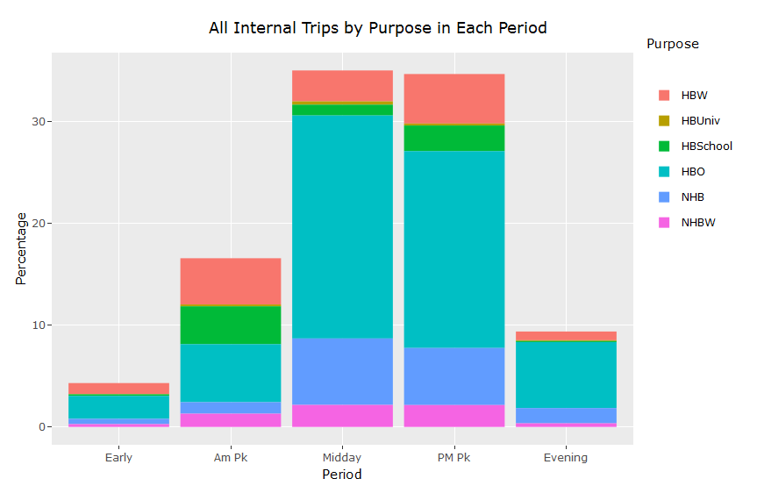
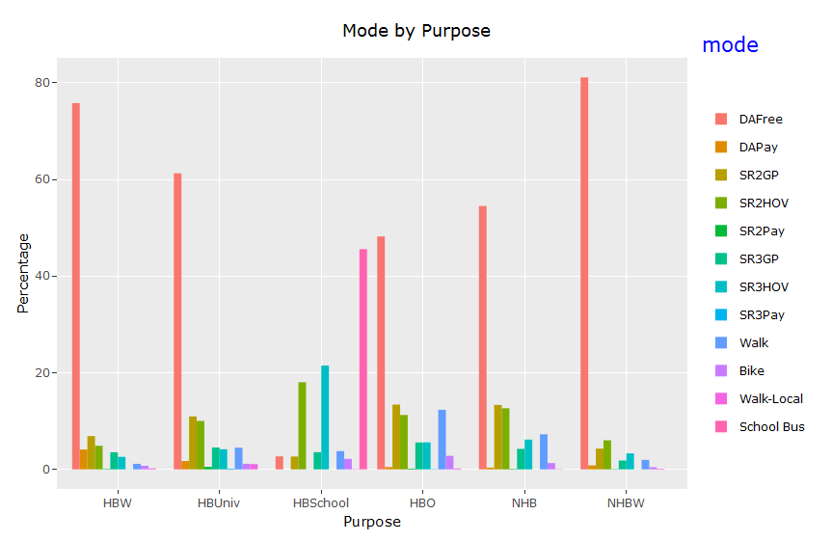
Trips (purposes translated to traditional trip purposes for comparison)

Slide 9
Trips per Household

Slide 10
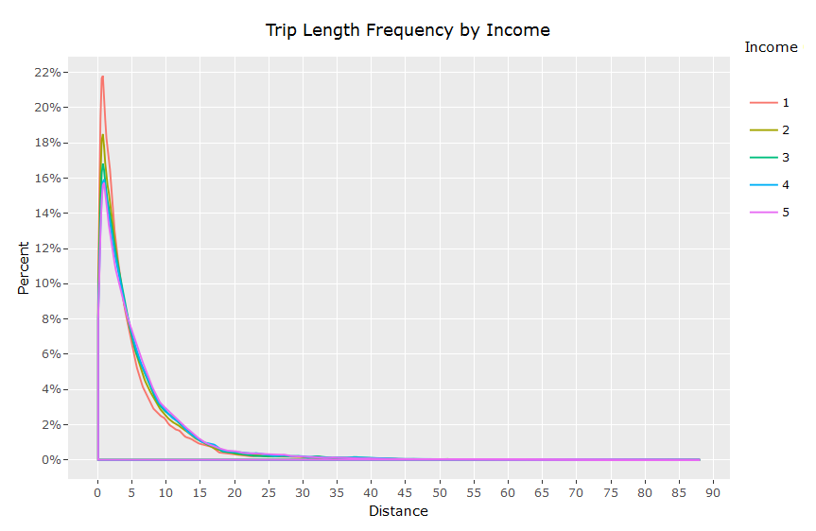
Trip Length Frequency Distribution (from destination choice)
All trips
By Income Group

Slide 11
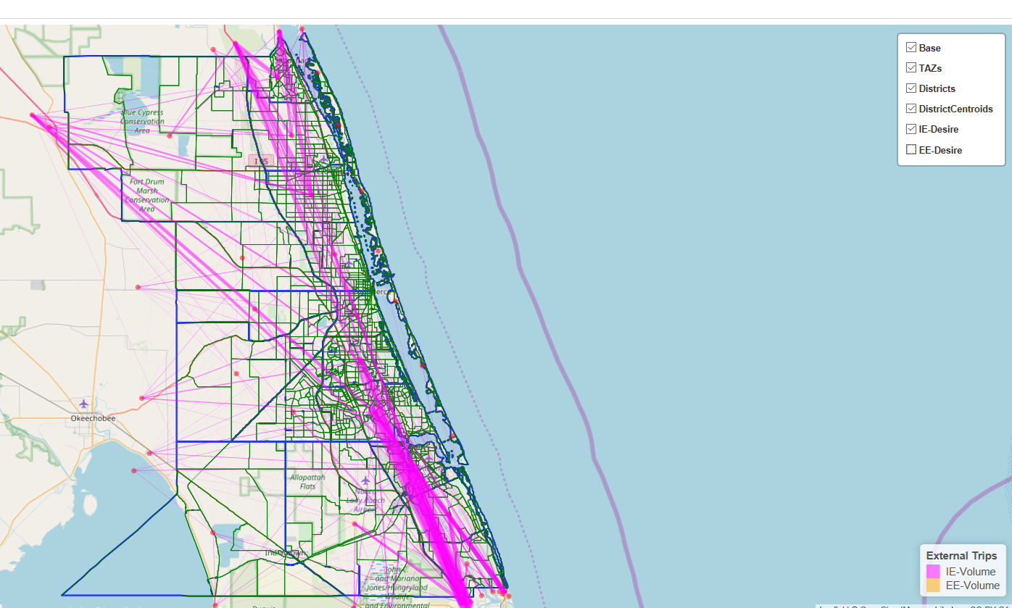
External Travel – Internal-External Desirelines

Slide 12
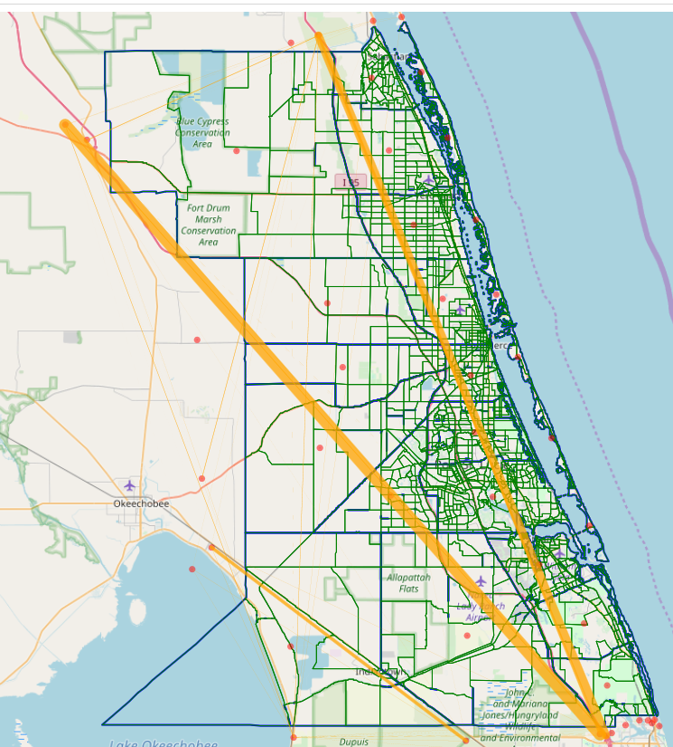
External Travel: External-External Desirelines

Slide 13
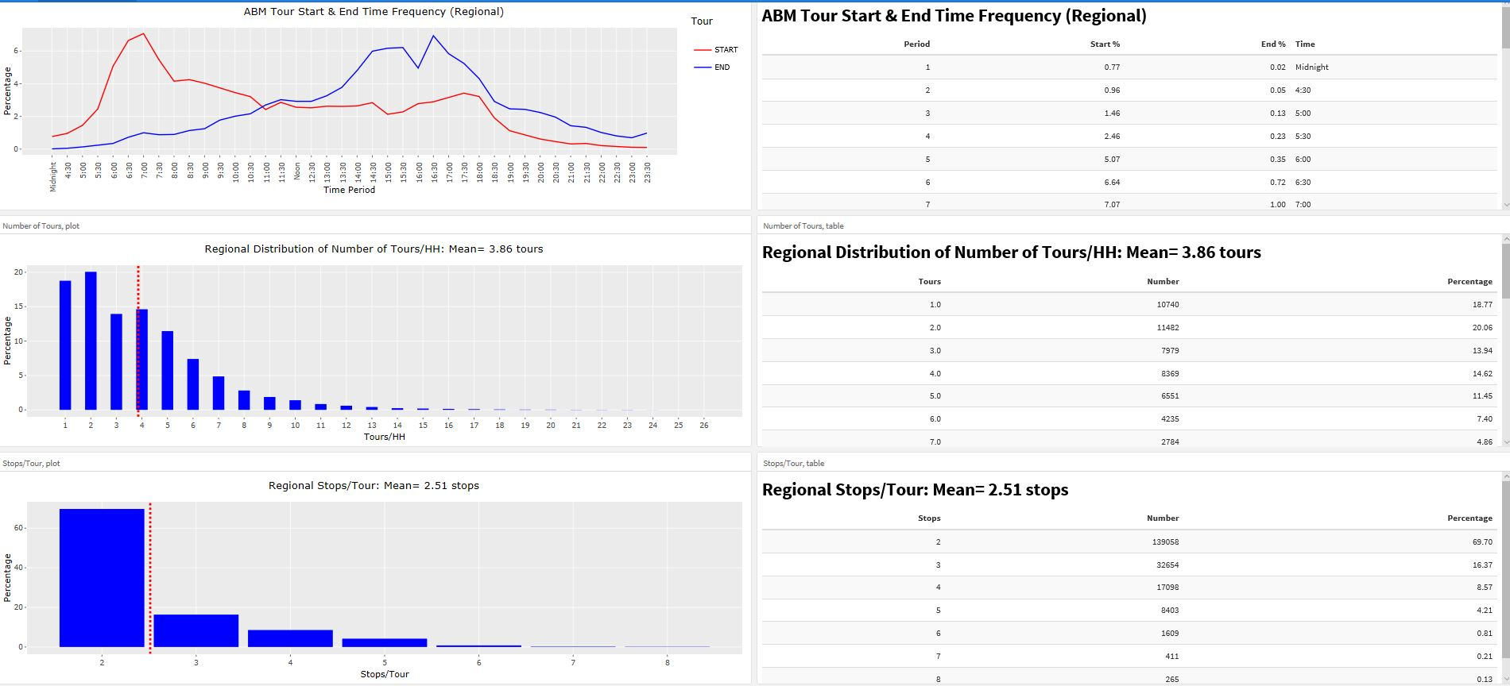
ABM Tour Output (Regional, County-specific, Tour purpose)

Slide 14
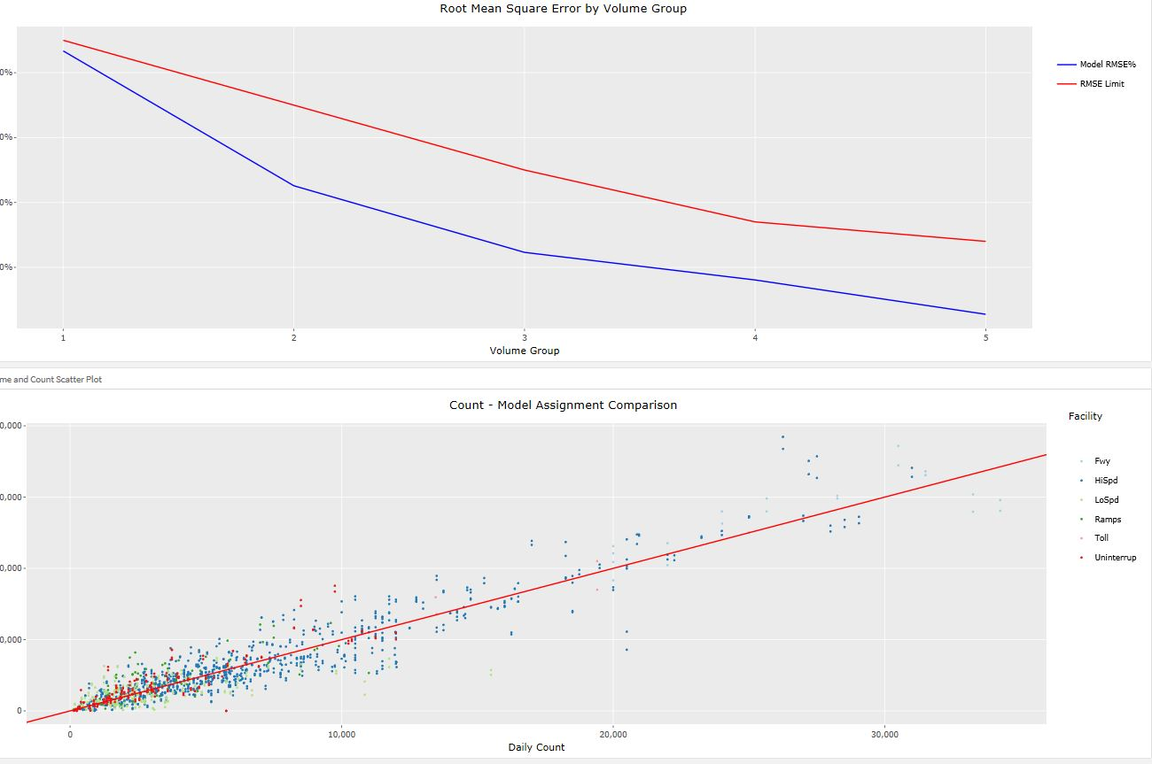
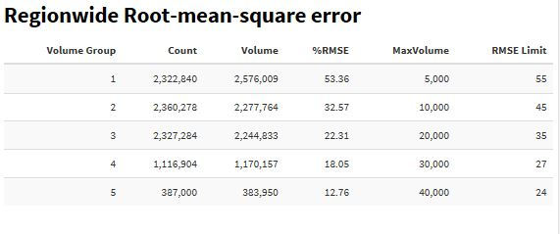
Model Validation

Slide 15
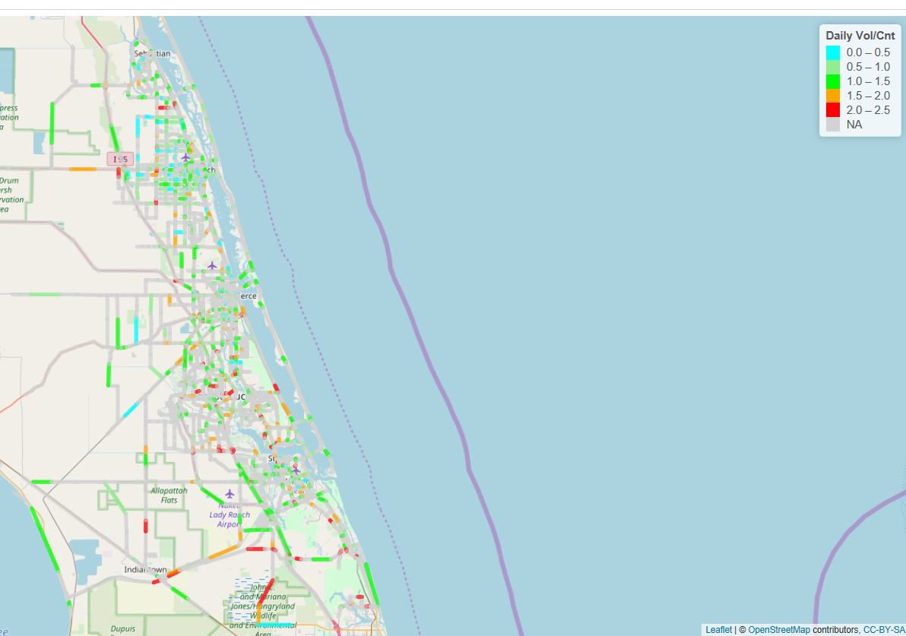
Model Validation – Volume/Count Displays
Available for all time periods. This one is daily.

Slide 16
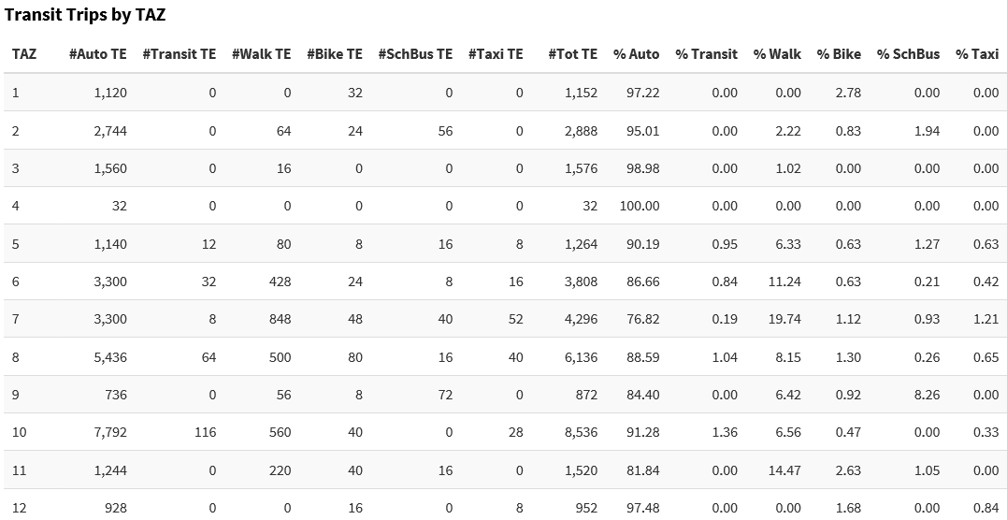
Mode Choice – All Modes by TAZ

Slide 17
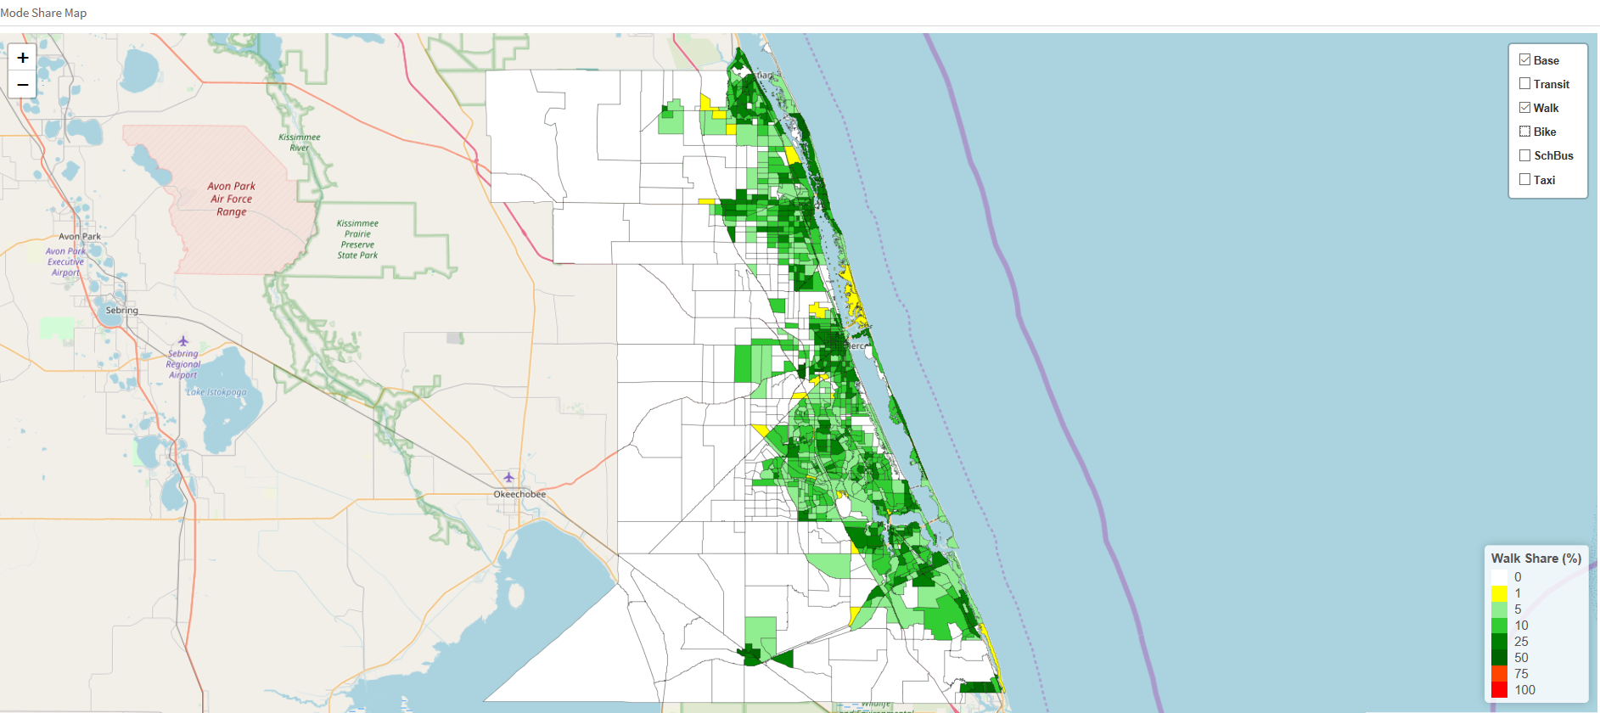
Mode Choice – Walk Share

Slide 18
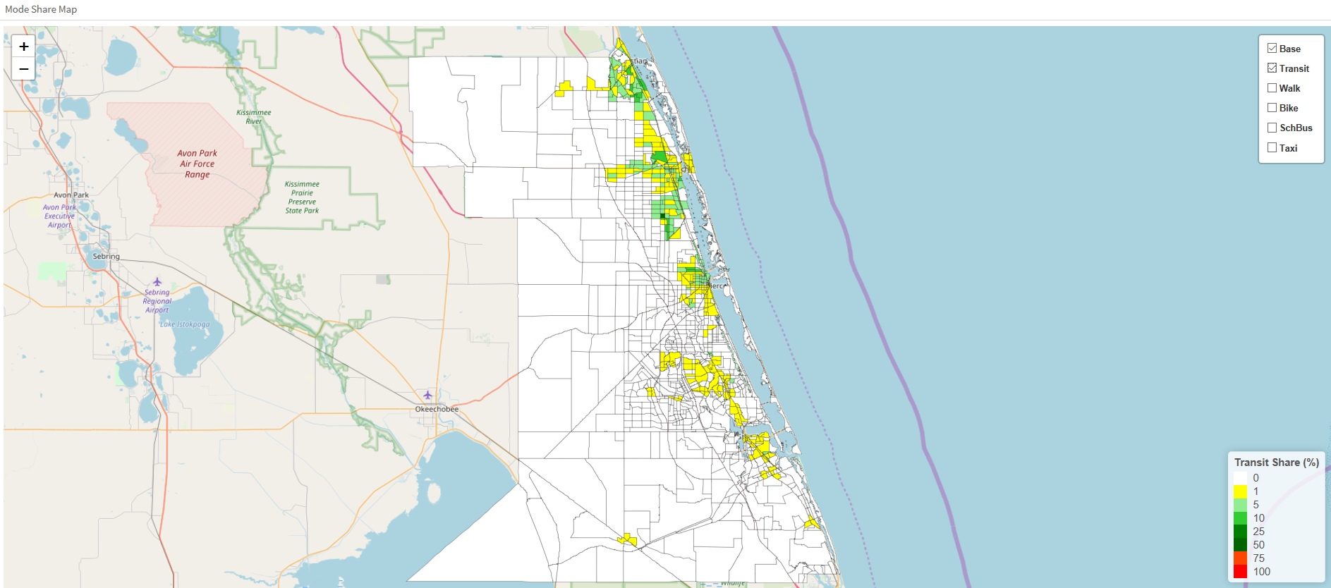
Mode Choice – Transit Share

Slide 19
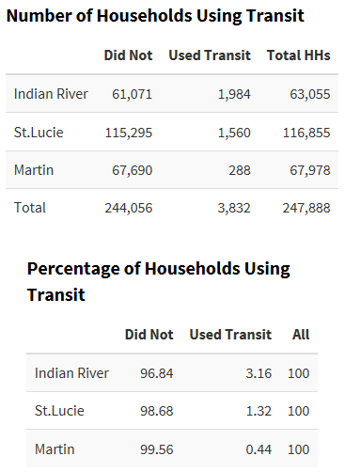
Mode Choice – Household Transit Use by County

Slide 20
More to come!
Replace most (or all) Cube Matrix reports with R-based reports
Expand transit, managed lane, HOV reporting
Create more map displays
Add many more Model Data reports

Slide 21
Thank You

